Slide 1

A Study on Gastrointestinal Disease Segmentation and Localization Using Deep Learning
R.L Chandrakantha
PS2316
EU/IS/2016/PHY/074
Department of Computing
Faculty of Science
Eastern University, Sri Lanka
Supervised by: Mr. S. Sotheeswaran
Senior Lecturer in Computer Science, Department of Computing, EUSL
April 08, 2024

Slide 2
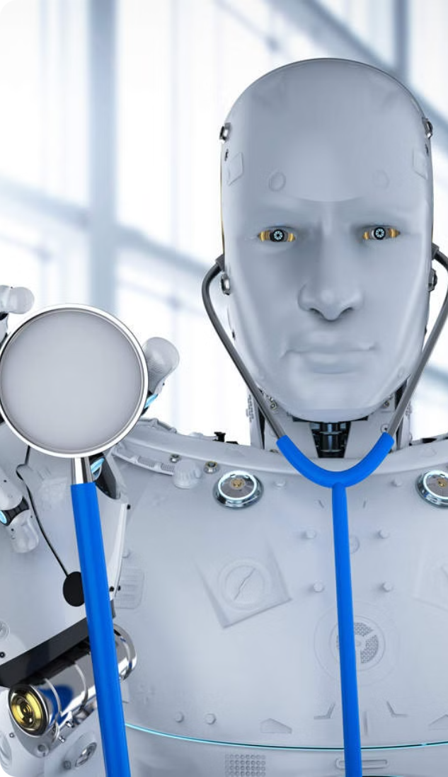
Overview
Abstract
Introduction
Objectives
Contribution
Related Works
Background
Methodology
Experimental Setup
Results and Discussion
Conclusion
Future Works
References

Slide 3
Abstract
Study
the challenge of accurate polyp segmentation in gastrointestinal disease diagnosis
Proposed Approach
Multi-scale Fusion Segmentation Network (MFSNet) including
Dataset
Kvasir-SEG with 1000 Polyp Images with Corresponding Ground Truth
Data Augmentation
Applies rotation, contrast adjustment, and resizing techniques to enhance model
Mean Dice Similarity Coefficient (mDSC): 0.937(with Augmentation)
Results
Mean Intersection over Union (mIoU): 0.915(with Augmentation)
Partial parallel decoder modules
Boundary-aware blocks
Reverse attention modules

Slide 4

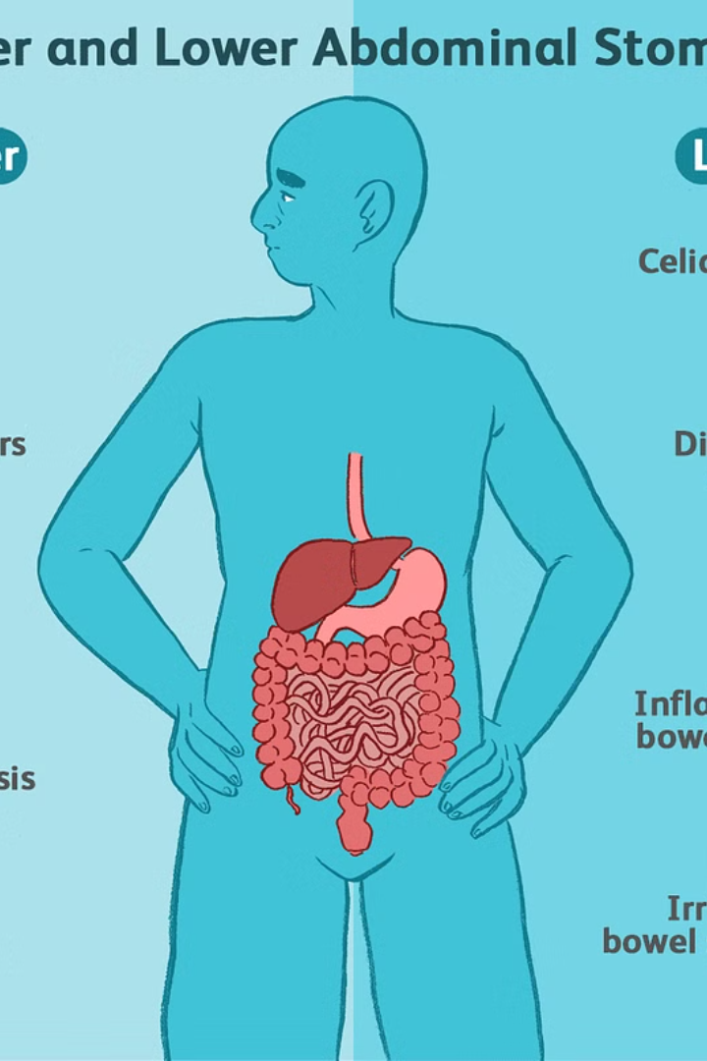
Introduction
Disease: Colorectal cancer, a lethal gastrointestinal disease.
Danger: High mortality rate, necessitating early detection to survive.
Miss Rates in Colonoscopies: Studies report miss rates of 14%-30%.Miss rates vary based on polyp characteristics.
Prediction Accuracy: Model achieves high accuracy in polyp segmentation.
Images Used: Gastrointestinal endoscopic images for detection.
Challenges: Manual detection can slow down the detection by variable polyp appearance.
Other Points:
AI aids in efficient detection and diagnosis.
Early intervention crucial for patient outcomes.

Slide 5
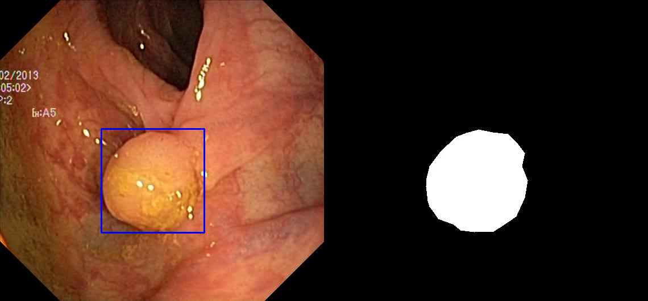
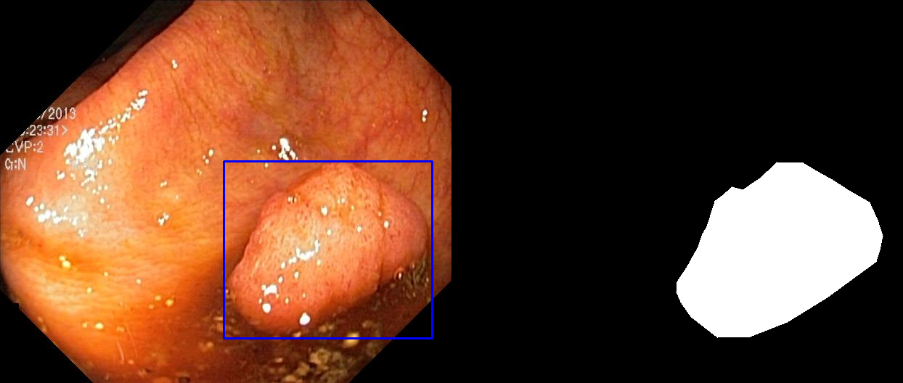
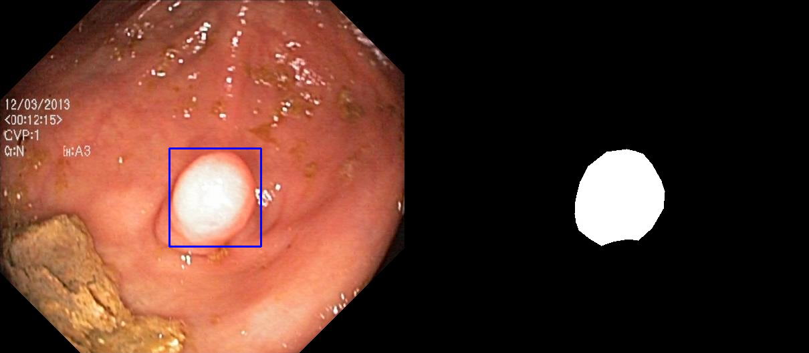
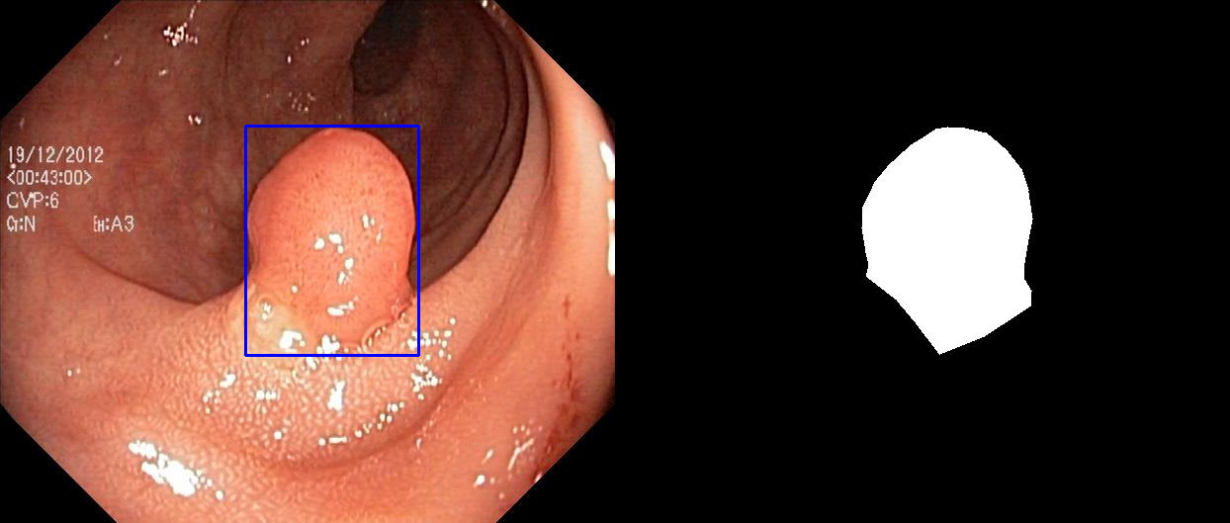
Introduction Cont..
Bounding Box
Ground Truth
Figure1:Polyp Image with Bounding box and Ground truth

Slide 6
Objectives
Model Development: Design and implement deep learning architectures.
Training and Optimization: Train models for optimal performance.
Performance Evaluation: Assess accuracy using standard metrics.
Comparative Analysis: Compare against state-of-the-art methods..
Dissemination and Knowledge Transfer: Share findings for wider impact.

Slide 7
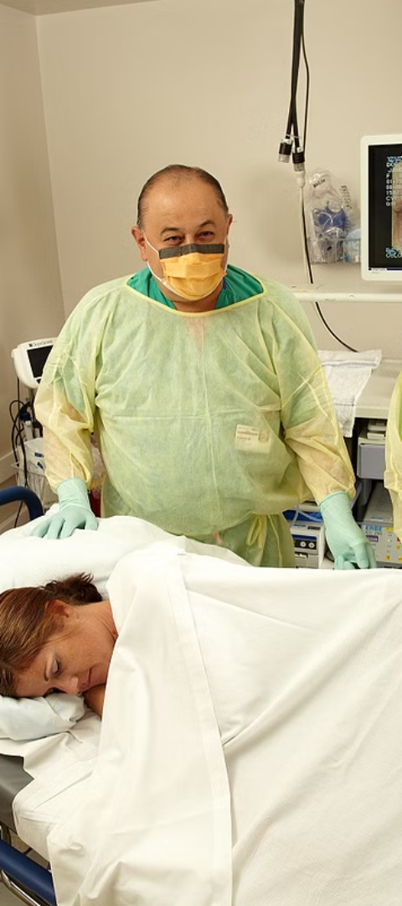
Contribution
Contribution of this study to segmenting infected gastrointestinal polyp images
Development of Specialized Techniques: Introducing novel algorithms and methodologies tailored specifically for the segmentation of infected gastrointestinal polyp images.
Improved Accuracy: Enhancing the accuracy and reliability of segmentation results through the utilization of advanced deep learning architectures and optimization techniques.
Performance Evaluation and Benchmarking: Conducting comprehensive performance evaluations and benchmarking against existing methods to provide insights into the effectiveness and superiority of the proposed approaches.
Contribution to Medical Research: Contributing valuable data and insights to the field of medical imaging research, advancing the understanding and management of gastrointestinal diseases, particularly in the context of polyp detection and segmentation.

Slide 8
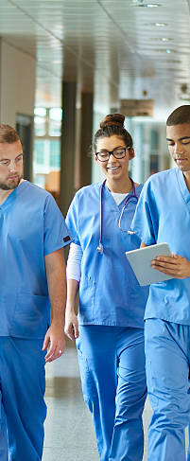
Related Work
Author and Year | Technique | Accuracy (Mean IoU/Dice)
Ronneberger et al. (2015) | U-Net | Mean Dice: 0.8180
Zhou et al. (2018) | UNet++ | Mean Dice: 0.8210
Deng-Ping Fan et al. (2020) | PraNet | Mean Dice: 0.898
Huang et al. (2021) | HarDNet-MSEG | Mean Dice: 0.904
Zhang et al. (2021) | TransFuse | Mean Dice: 0.918
Srivastava et al. (2021) | MSRF-Net | Mean Dice: 0.9217
Srivastava et al. (2021) | GMSRF-Net | Mean Dice: 0.9263
Sanderson and Matuszewski (2022) | FCBFormer | Mean Dice:0.9445
Dumitru et al. (2023) | DUCK-Net | Mean IoU: 0.905; Dice coefficient: 0.95
Trinh (2023) | Meta-Polyp | Mean IoU: 0.921; Dice coefficient: 0.959

Slide 9
Background
Machine Learning: That focuses on the development of algorithms and statistical models that enable computers to perform tasks without being explicitly programmed for those tasks. systems learn from data, identify patterns, and make decisions or predictions based on those patterns. The key idea is to enable computers to learn from experience, just like humans, and improve their performance over time. There are several types of machine learning approaches, including:
Supervised Learning
Unsupervised Learning
Reinforcement Learning
Semi-supervised Learning
Deep Learning: That focuses on artificial neural networks, particularly deep neural networks with many layers. Deep learning algorithms are inspired by the structure and function of the human brain, specifically the interconnected networks of neurons. Key characteristics of deep learning include:
Neural Networks
Deep Architectures
Representation Learning
Scalability

Slide 10
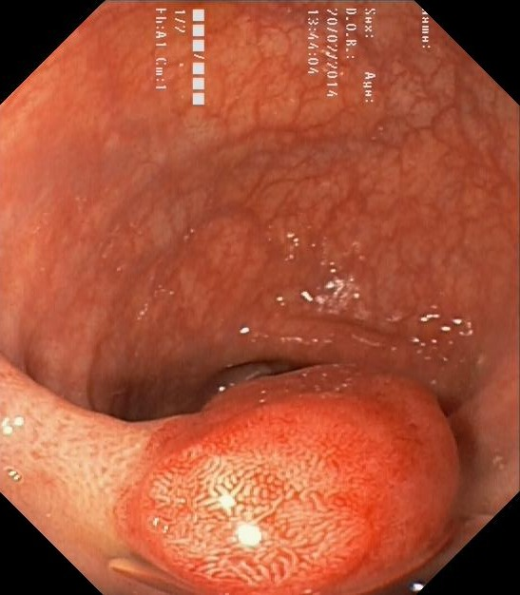
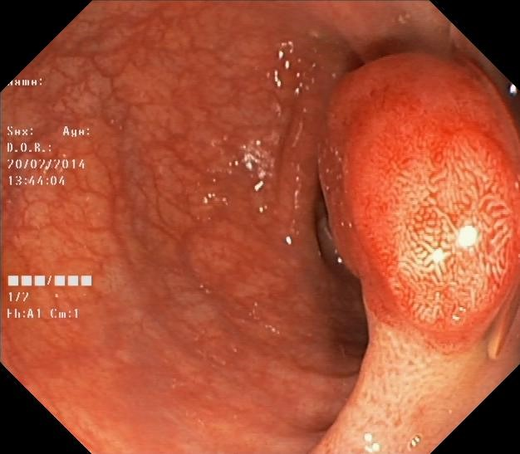
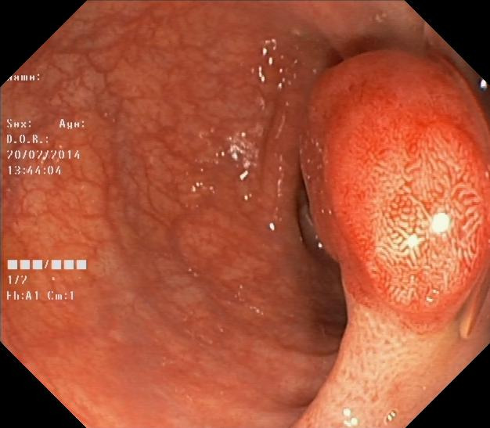
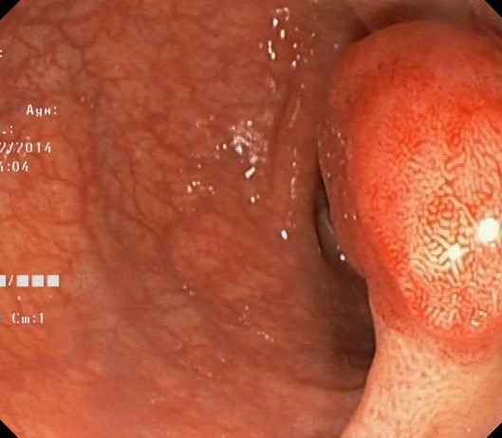
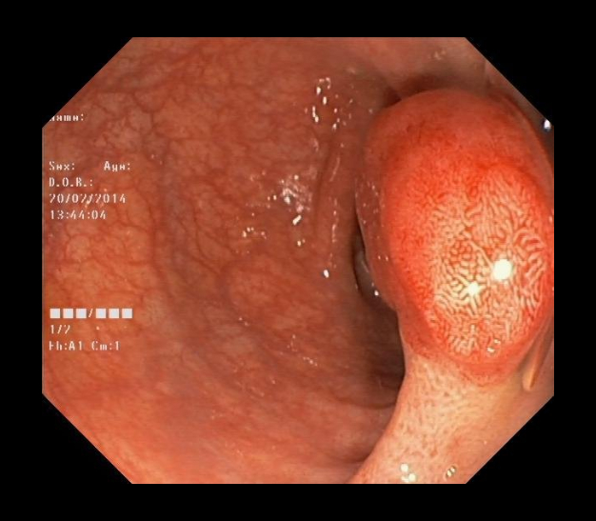
Methodology cont..
Pre-processing
Image rescaling
Data augmentation
Rotation
Contrast
Resize(Zoom)
Inverse Resize(Inverse Zoom)
Rotation
Contrast
Resize
Inverse Resize

Slide 11
Methodology cont..
Deep Supervision
Utilizes a hybrid loss function for improved segmentation performance.
Combines weighted BCE and weighted IoU loss functions for global and local supervision.
Enhances both image-level and pixel-level segmentation.
Employs side outputs from the CNN upsampled to form segmentation maps.
Overall loss function extends to incorporate deep supervision.

Slide 12
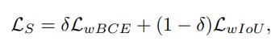
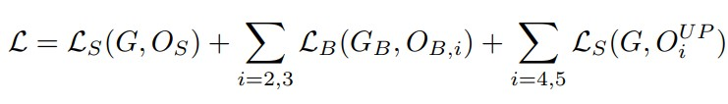
Methodology cont..
Deep Supervision: Mixed Loss Function
for the overall segmentation supervision, we employ a mixed loss function to ensure effective global and local supervision, enhancing both image-level and pixel-level segmentation. This mixed loss function combines the weighted BCE loss function (LwBCE) and the weighted Intersection over Union (IoU) loss function (LwIoU).
Figure 2 : Mixed loss function
Figure 3 : overall loss function

Slide 13
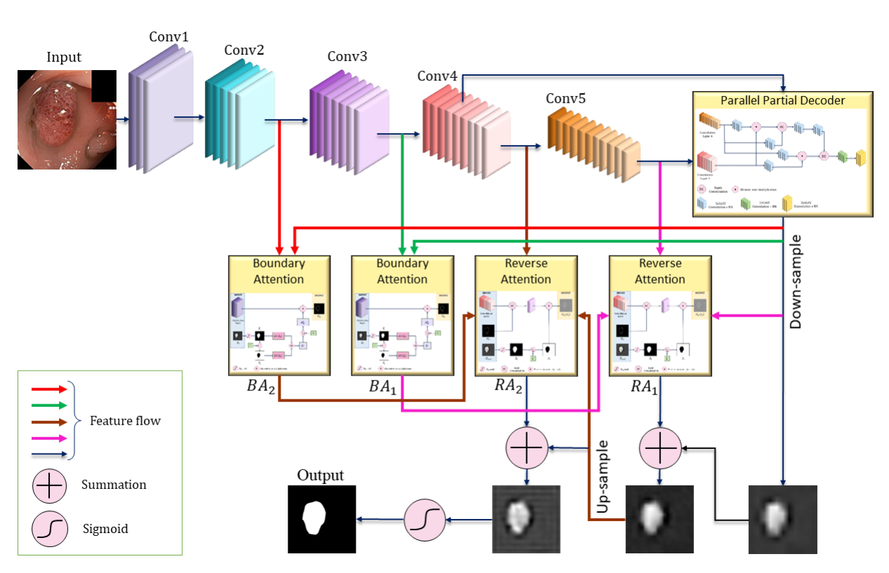
Methodology cont..
Augmented and without Augmented
Figure 5 :The Proposed MFSNet Model with Augmentation

Slide 14
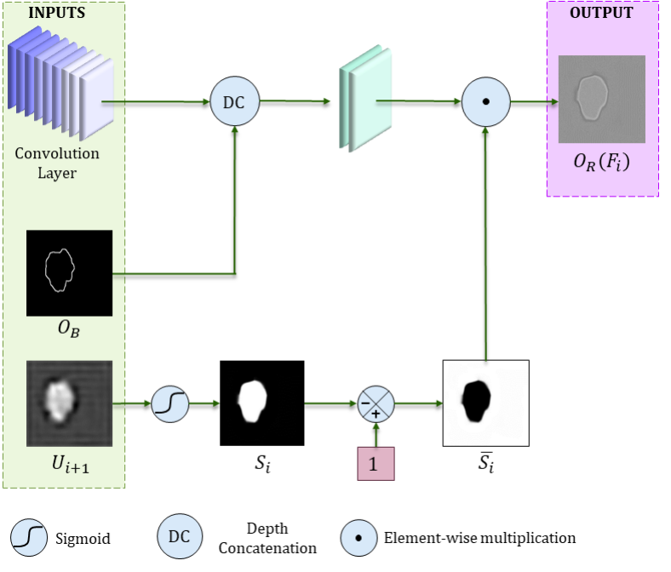
Methodology cont..
Figure 6 : Architecture of the Reverse Attention module

Slide 15
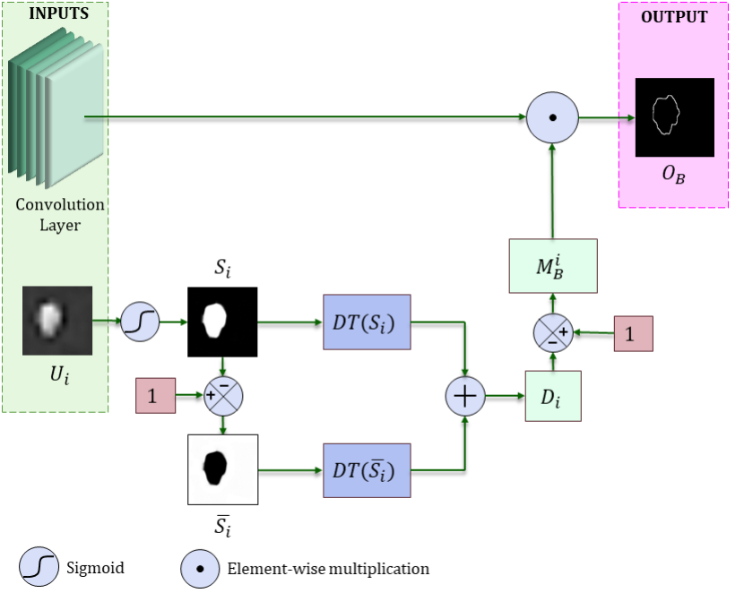
Methodology cont..
Data Transformation
Figure 7: Architecture of the Boundary Attention module

Slide 16
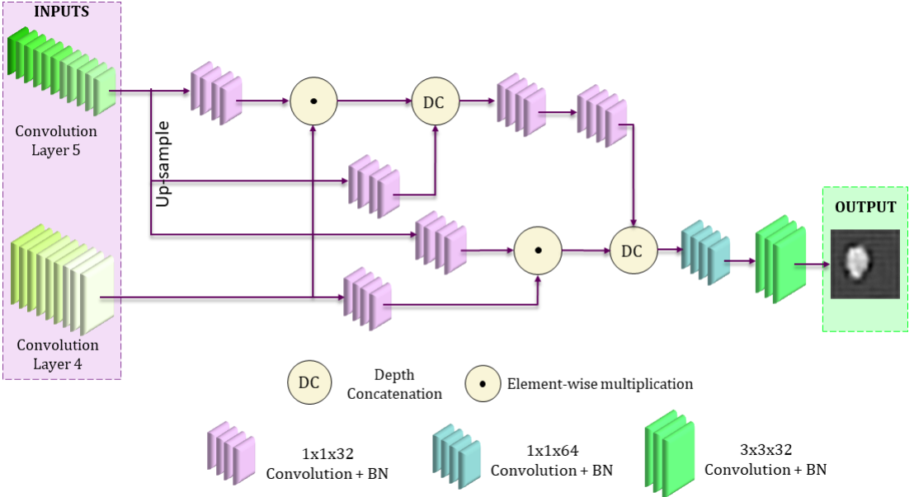
Methodology cont..
Figure 8: Partial Parallel Decoder Module

Slide 17
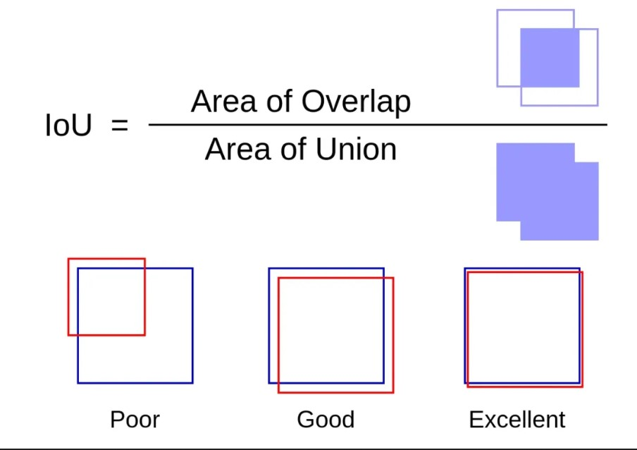
Methodology cont..
Figure 8: Intersection Over Union

Slide 18
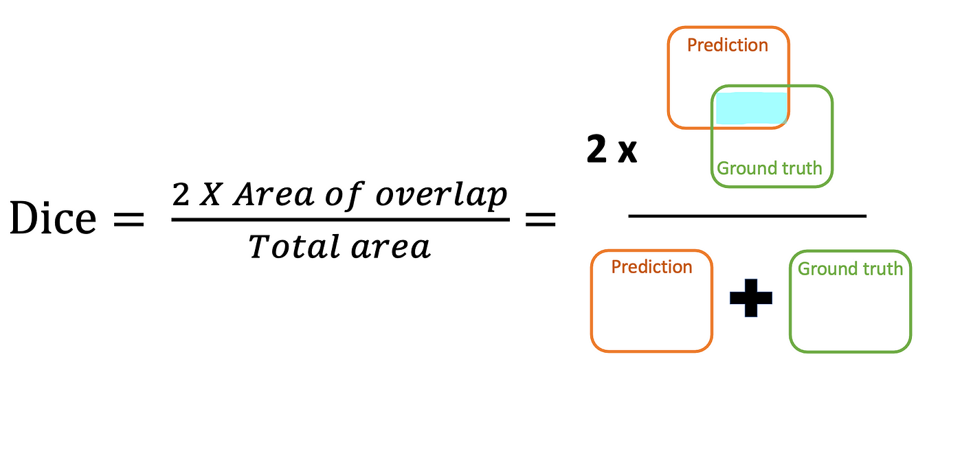
Methodology cont..
Figure 8: Dice Coefficient

Slide 19
Experimental Setup
Data Split
Training Images(60%) | Validation Images(20%) | Testing Images(20%)
600 | 200 | 200

Slide 20
Experimental Setup cont..
Image Augmentation
Initially, image augmentation is performed using various filters, as shown below:
Training Augmentation Range
Method | Images and Masks
Rotation | {-50% – 50%}
Contrast | {-50% – 50%}
Resize(Zoom) | {-10% – 10%}
Inverse Resize(Inverse Zoom) | {-10% – 10%}

Slide 21
Experimental Setup cont..
Image Augmentation
Testing Augmentation Range
Method | Images and Masks
Rotation | {-50% – 50%}
Contrast | {-50% – 50%}
Resize(Zoom) | {-50% – 50%}

Slide 22
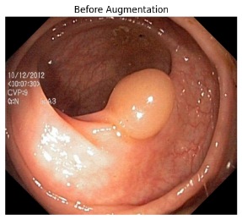
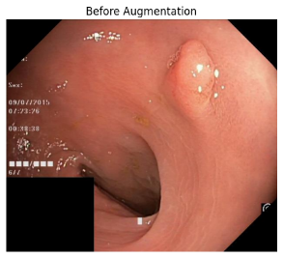
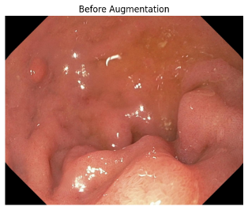
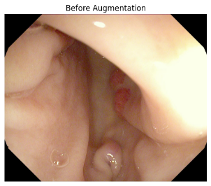
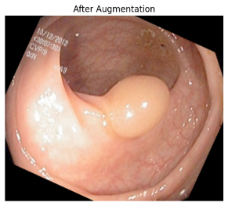
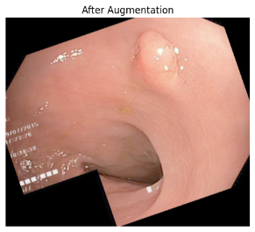
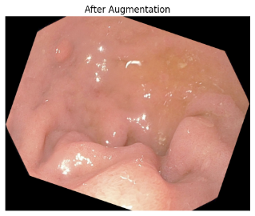
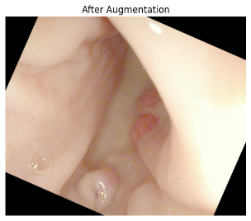
Experimental Setup cont..
Image Augmentation
Before
After
Figure4: Random Augmented Polyp Images

Slide 23
Results and Discussion
Model
Augmentation
mDSC
mIoU
MFSNet
No Augmentation
0.872
0.858
MFSNet
Rotation & Contrast
0.905
0.872
MFSNet
Resizing
0.921
0.901
Rotation, Contrast, & Resizing
MFSNet
0.937
0.915
MFSNet
Inverse Resizing
0.851
0.835

Slide 24
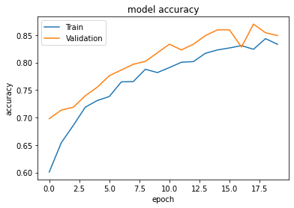
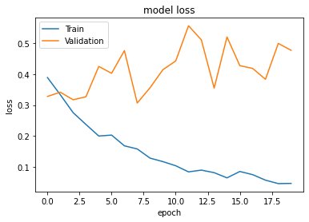
Results and Discussion cont..
Figure 9: Model Accuracy
Figure 10: Model Loss

Slide 25
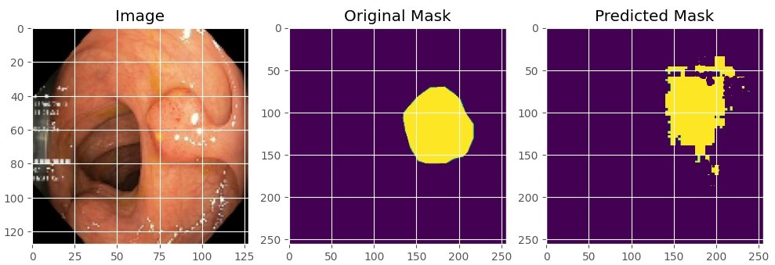
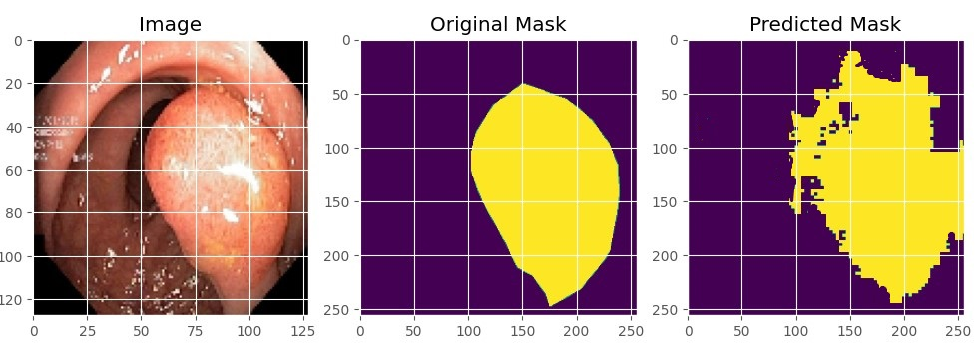
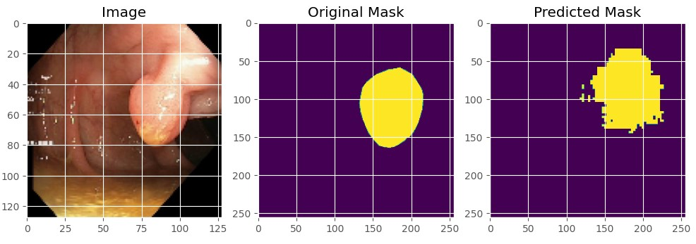
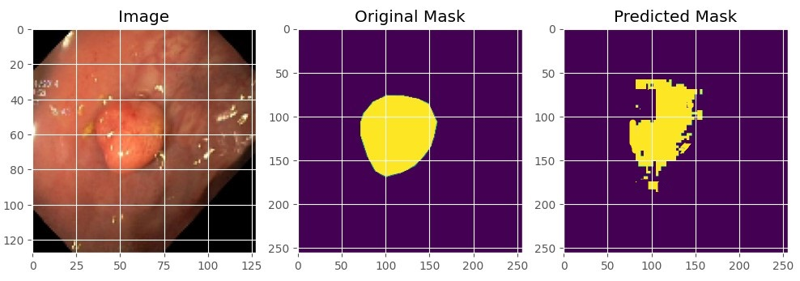
Results and Discussion cont..
Figure 11: Original Mask vs Predicted Mask

Slide 26
Conclusion
The MFSNet model achieved significant accuracy scores in polyp segmentation:
Mean IoU (mIoU) score: 91.5%
Mean Dice similarity coefficient (mDSC): 93.7%
Augmentation techniques including rotation, contrast adjustment, and resizing were utilized.
These techniques contributed to the enhancement of the model's accuracy.
Augmentation strategies may lead to varying levels of improvement.
Some cases demonstrated enhanced performance compared to scenarios without augmentation.
Careful selection and application of augmentation techniques are essential based on the dataset's specific characteristics to optimize model performance.

Slide 27
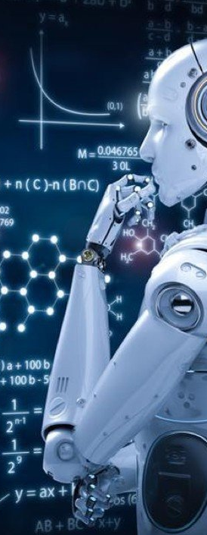
Future Works
Incorporating Additional Augmentation Techniques: Explore advanced augmentation methods for improved model robustness.
Fine-tuning Hyperparameters: Optimize learning rate, batch size, and network architecture for better performance.
Exploring Optimizers: Investigate the impact of different optimizers on model training.
Dataset Expansion: Augment dataset with diverse gastrointestinal disease images.
Clinical Validation and Deployment: Evaluate model performance in real-world clinical settings.

Slide 28
References
Basak, H., Kundu, R., & Sarkar, R. (2022). MFSNet: A multi focus segmentation network for skin lesion segmentation. Pattern Recognition, 128, 108673.
DiSanto, N., Harding, G., Martinez, E., & Sanders, B. (2022). Leveraging Contextual Data Augmentation for Generalizable Melanoma Detection. arXiv preprint arXiv:2212.05116.
D. Jha et al. (2021). Real-Time Polyp Detection, Localisation and Segmentation in Colonoscopy Using Deep Learning. IEEE Acc.
Dumitru, R. G., Peteleaza, D., & Craciun, C. (2023). Using DUCK-Net for polyp image segmentation. Scientific reports, 13(1), 9803.

Slide 29
References cont..
O. Ronneberger, P. Fischer, and T. Brox. (2015). U-net: Convolutional networks for biomedical image segmentation. [Online]. Available https://arxiv.org/abs/1505.04597
Trinh, Q. H. (2023, June). Meta-Polyp: a baseline for efficient Polyp segmentation. In 2023 IEEE 36th International Symposium on Computer-Based Medical Systems (CBMS) (pp. 742-747). IEEE.
Y. Guo, J. Bernal, and B. J Matuszewski. (2020). Polyp segmentation with fully convolutional deep neural networks — extended evaluation study. Jour. of Imag., vol. 6, no. 7, p. 69.

Slide 30
THANK YOU!

Slide 31
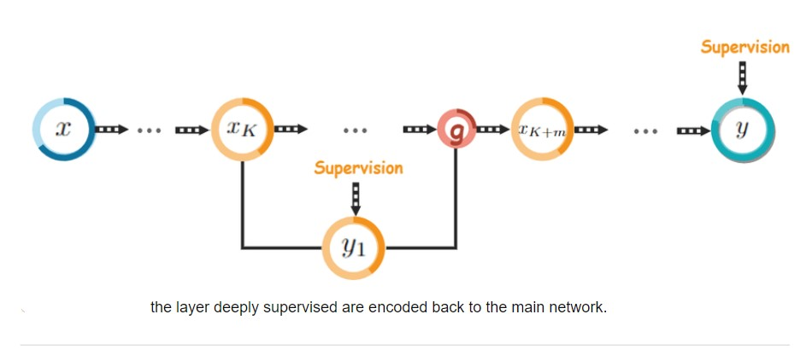
Deep Supervision

Slide 32
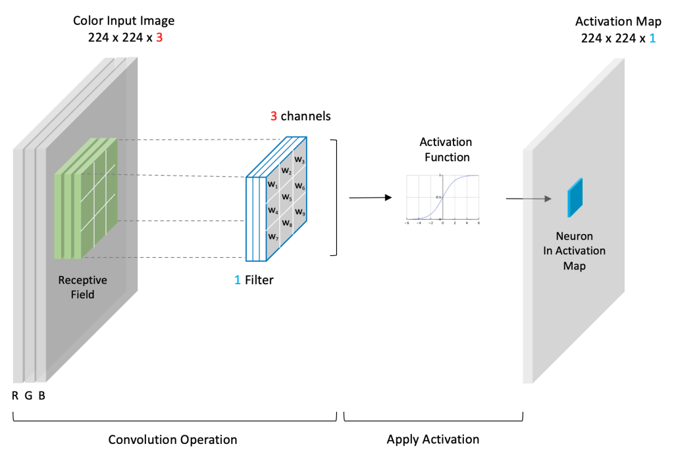
Convolutional Layer

Slide 33
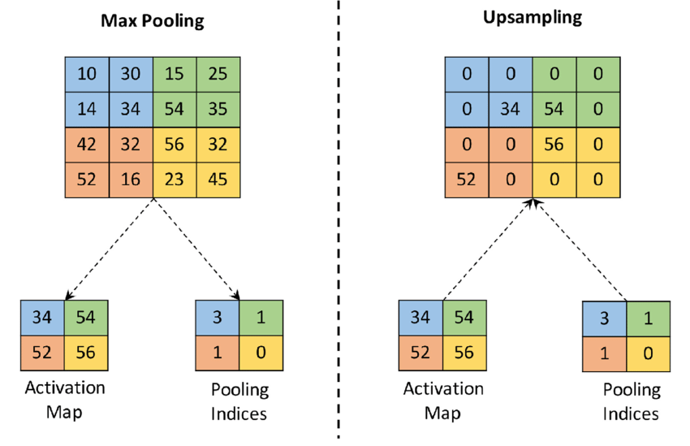
Upsampling and Downsampling

Slide 34
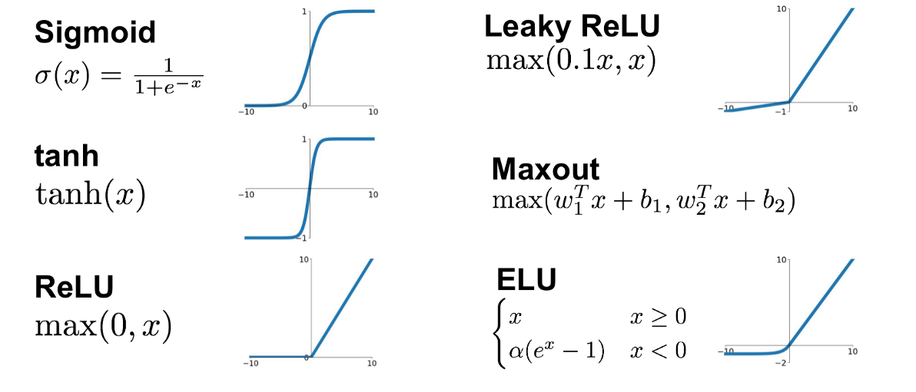
Activation Function

Slide 35
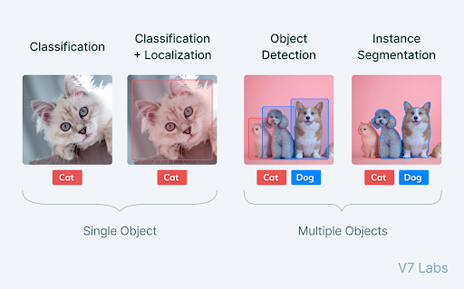

Slide 36
Implementing Code
The implementation of MFSNet in code involves defining the architecture using a deep learning framework ( pytorch)
Each component of the MFSNet architecture (e.g., backbone network, RA modules, BA module, PPD module) is implemented as a separate module or layer in the neural network.
The hyperparameters of the model, such as learning rate, batch size, optimizer choice, and regularization parameters, are specified in the training script.
The model is trained using a suitable dataset for the segmentation task, and the training process involves forward and backward passes through the network to update the model parameters based on the chosen loss function.
After training, the model can be evaluated on a separate validation or test dataset to assess its performance using appropriate evaluation metrics.

Slide 37
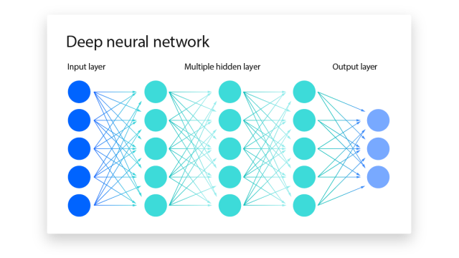
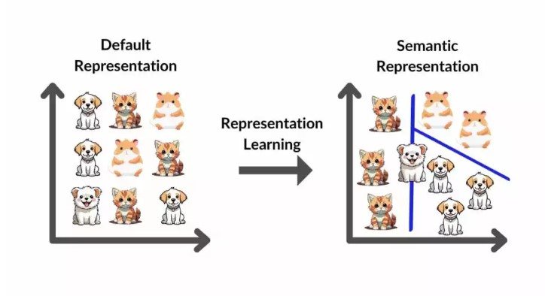

Slide 38
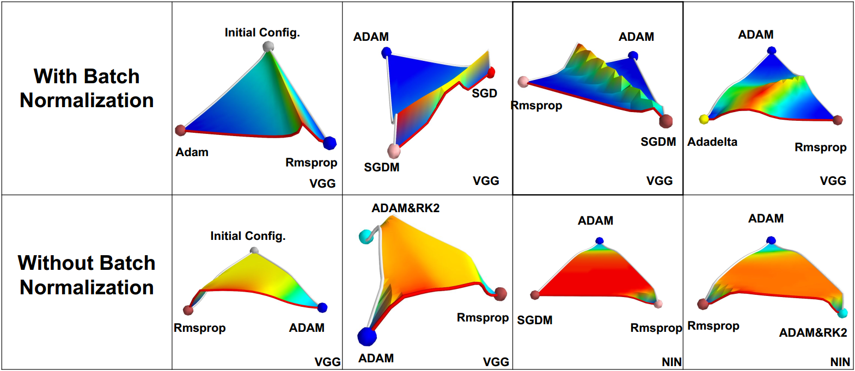
Optimizers

